Slide 1
Vivify Academy

Slide 2
HTML & CSS
Vivify Academy

Slide 3
Week overview
Anatomy of a web page
Semantic HTML
Basic CSS styling
Targeting HTML elements with CSS selectors
Box model basics
Layouts with Flexbox and CSS-Grid
Responsive layouts with Media Queries
Tips & Tricks

Slide 4
Notes and warnings
Lose the fear
Fundamentals, not frameworks
Practise makes perfect
Experiments make us go further
Google the shit out of it
Notes:
Za razliku od JS framework-a (Angular, Vue, React), HTML/CSS biblioteke su previše ograničavajuće sa strane dizajna i zato se ne preporučuju. One se prvenstveno koriste za izradu jednostavnih prototipova.

Slide 5
Anatomy of a web page
Day 1

Slide 6
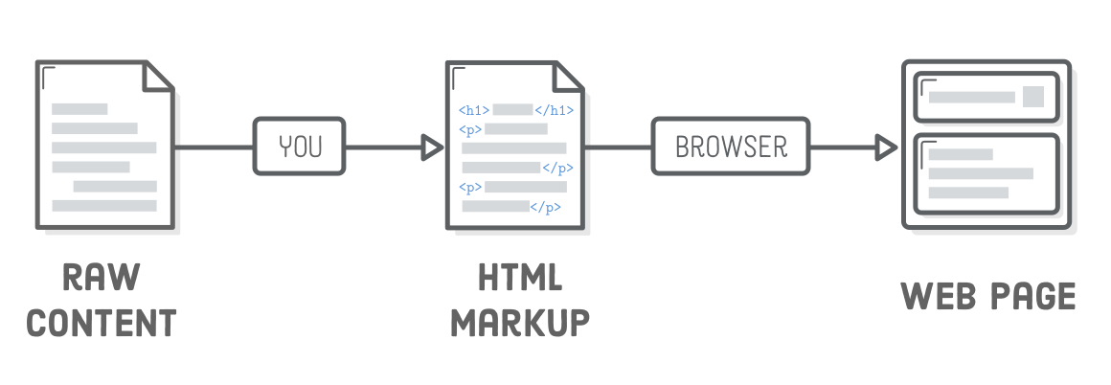

Slide 7
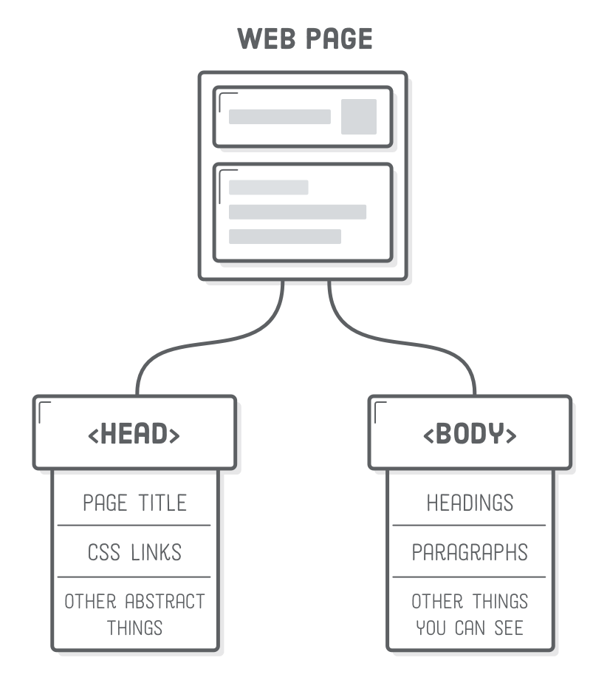

Slide 8
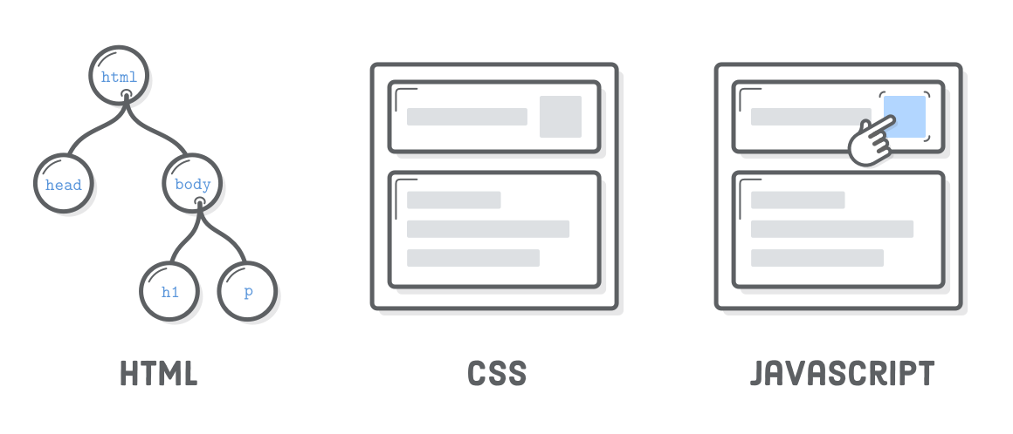

Slide 9
HTML is for adding meaning to raw content by marking it up.
CSS is for formatting that marked up content.
JavaScript is for making that content and formatting interactive.

Slide 10
HTML basics

Slide 11
<house>
<living-room></living-room>
<kitchen>
<table></table>
<chair></chair>
</kitchen>
<bedroom>
<bed>
<pillow></pillow>
<cover></cover>
</bed>
</bedroom>
<bathroom></bathroom>
</house>
Notes:
HTML definiše strukturu web stranice, kao što prostorije definišu strukturu stana.

Slide 12
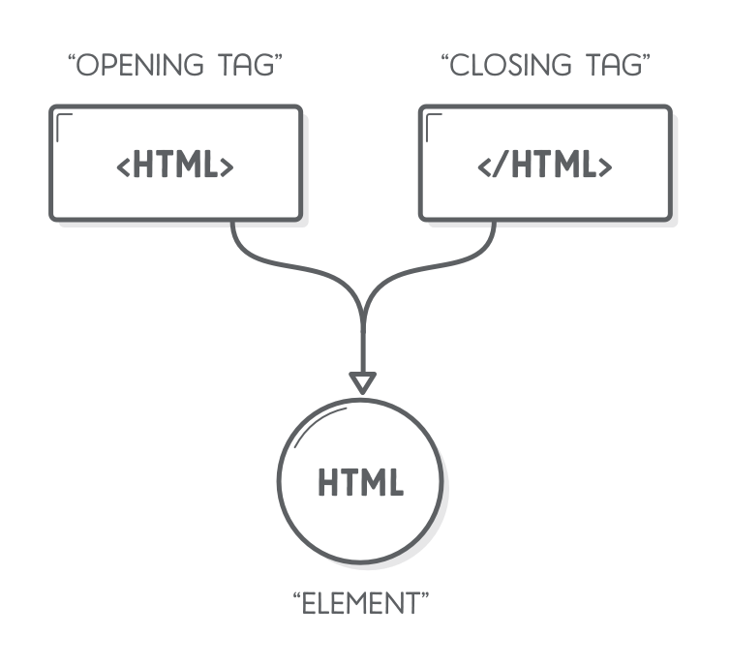
First, some basics
Notes:
Svaki HTML element se sastoji od otvarajućeg i zatvarajućeg taga i najbitnije je da svaki otvarajući tag ima svog zatvarajućeg para. Svaki HTML element može da ima razne atribute kao što su ID, CLASS itd. koji služe za prosljeđivanje raznih informacija i povezivanje sa CSS-om i JavaScript-om. Atributi se upisuju u ‘otvarajući’ dio html taga

Slide 13
<html> <head> <title>HTML is a piece of cake</title> <meta charset=”utf-8” /> <meta name="viewport" content="width=device-width, initial-scale=1"> <link rel="stylesheet" type="text/css" href="theme.css"> <!-- Some other stuff goes here --> </head> <body> <!-- Visible content goes here --> </body> </html>
Notes:
Napomenuti da se tagovi nalaze jedan u drugom, da se gnijezde.

Slide 14
Tag Attributes
ID attribute must be unique; Only one element can have the same ID
Class attribute can hold multiple classes and doesn’t have to be unique
<body> <h1 attribute-name=”attribute-value”>This is biggest heading</h1> <h2 id=”hero-section-title”>Next smaller headline</h2> <h2 class=”primary-title secondary-class”>Next smaller headline</h2> </body>

Slide 15
Nesting
<head> <title>Tag order is important!</head> </title>

Slide 16
Headings and paragraphs
<h1> This is biggest heading on the page </h1>
<p> And this is paragraph of text. </p>
<h2> This is second biggest heading </h2>
<p> And this is another paragraph of text. </p>

Slide 17
Lists
<ul> <li>First item</li> <li>Second item</li> </ul> <ol> <li>First item</li> <li>Second item</li> </ol>

Slide 18
Styling text
<p> And <strong>this is</stong> another paragraph <em>of text</em>. </p>

Slide 19
HTML tables
<table> <thead> <tr> <th>Name</th> <th>Position</th> </tr> </thead> <tbody> <tr> <td>Company X</td> <td>Development</td> </tr> <tr> <td>Company Y</td> <td>Design</td> </tr> </tbody> <tfoot></tfoot> </table>

Slide 20
Form elements
<form> <label>Your name</label> <input type=”text” placeholder=”John Doe”/> <label>Your Email</label> <input type=”email” placeholder=”john@doe.com”/> <label>Your Phone number</label> <input type=”phone” placeholder=”000-000-000”/> <p>Can I call you back</p> <input type=”radio” name=”callback” checked> <label for=”callback”>Yes</label> <input type=”radio” name=”callback”> <label for=”callback”>No</label>

Slide 21
<label>Are you sure?</label> <input id=”callback” type=”checkbox” /> <label for=”callback”>Yes</label> <label for=”subject”>What do you want to talk about</label> <select id="subject" multiple required> <option name=”1” value=”1”>Weather</option> <option name=”2” value=”2”>Sports</option> <option name=”3” value=”3”>Computers</option> </select> <label for=”message”>Your Message</label> <textarea id=”message” rows=”5”></textarea> <button>Send</button> </form>

Slide 22
Images and links
<img src=”images/logo.png” alt=”This is our logo” width=”100” height=”50” />
<a href=”http://vivifyideas.com” title=”Vivify Ideas website” target=”_blank”> Vivify Ideas </a>

Slide 23
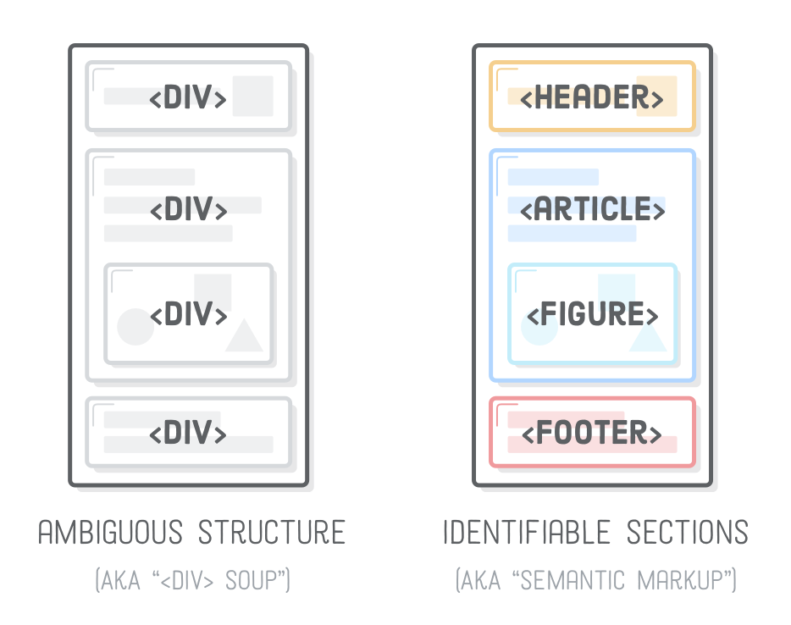
Meaningful (Semantic) HTML

Slide 24
<body class=”main-page”> <header> <!-- This is page’s header --> <h1 class=”page-title”> This is our awesome page! </h1> </header> <main> <!-- This is page’s main content --> <p> This is paragraph that <a href=”page.html” title=”#”>has a link.</a> </p> </main> <aside> <!-- This is additional page content or ‘sidebar’ --> <nav> <ul> <li><a href=”index.html” title=”Homepage”>Home</a></li> <li><a href=”about.html” title=”About me”>About</a></li> <li><a href=”contact.html” title=”Contact me”>Contact</a></li> </ul> </nav> </aside> <footer> </footer> </body>

Slide 25
Code commenting
<h1 id=”page-title”> This is biggest heading on the page <!-- This is HTML comment and won’t be visible in browser --> </h1>
body { color: #414141; background-color: #EEEEEE; /* This is CSS comment */ }

Slide 26
CSS basics

Slide 27
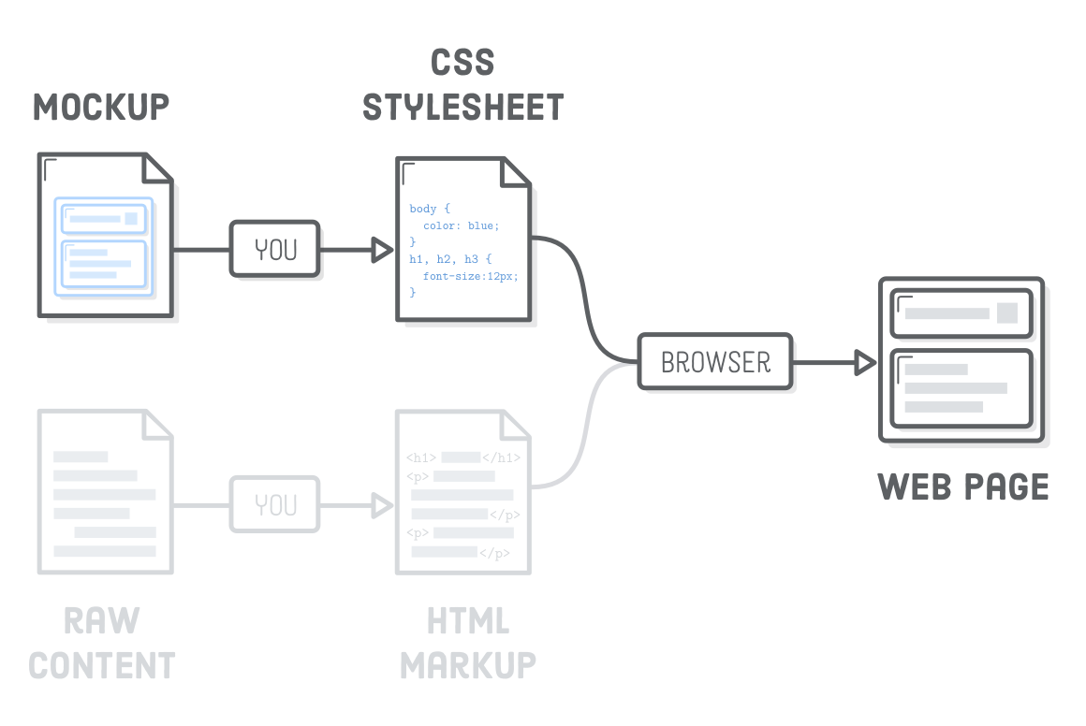

Slide 28
Linking CSS to HTML
<html> <head> <title>HTML is a piece of cake</title> <link rel="stylesheet" type="text/css" href="theme.css"> </head> <body> <h1> This is biggest heading on the page </h1> <p> This is paragraph that <a href=”page.html” title=”#”>has a link.</a> </p> </body> </html>

Slide 29
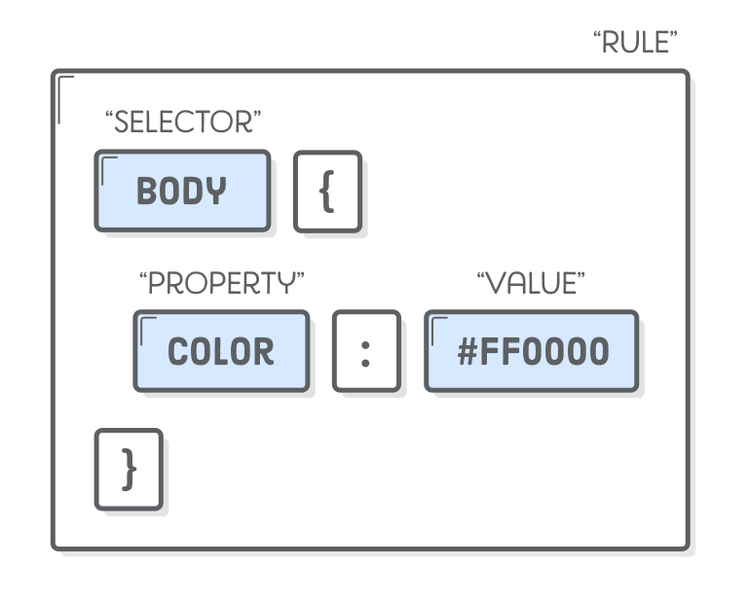

Slide 30
Selecting different HTML elements
body { color: #414141; background-color: #EEEEEE; } h1 { font-size: 36px; }

Slide 31
Grouping multiple selectors
/* This is redundant and unnecessary */ h1 { font-family: "Helvetica", "Arial", sans-serif; } h2 { font-family: "Helvetica", "Arial", sans-serif; } h3 { font-family: "Helvetica", "Arial", sans-serif; }
/* This is better */ h1, h2, h3 { font-family: "Helvetica", "Arial", sans-serif; }

Slide 32
Basic styling
body { background-color: #cccccc; color: #999999; } h1 { font-family: "Helvetica", "Arial", sans-serif; background-color: #666666; color: #ffffff; } p { text-align: right; } a { color: #00ff00; text-decoration: none; font-weight: bold; }

Slide 33
List styling
ul { list-style-type: circle; } ol { list-style-type: lower-roman; }

Slide 34
Background images
body { background-image: url(‘../images/background.jpg’); background-position-x: 0; background-position-y: 0; background-repeat: no-repeat; }

Slide 35
Units in CSS
body { font-size: 10px; width: 100vw; height: 100vh; } h1 { width: 75%; } p { font-size: 1rem; }

Slide 36
Resources

Slide 37
www.w3c.org
www.w3schools.com
https://developer.mozilla.org/
www.css-tricks.com
https://alistapart.com/article/dao

